Slide 1
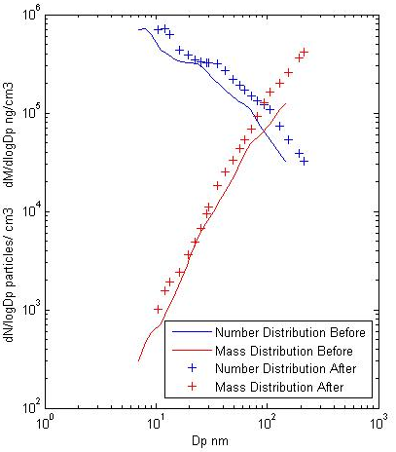
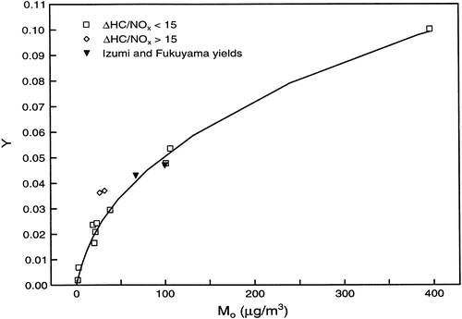
SOA Partitioning with Pre-existing Particles: Size-independent? -Jun Liu
SIO 217 D
Yield Calculation:
-reacted amount of ROG is 2000 micog/m⁻³;
-Yield Calculated from Odum 1996 is 4.01%
Partitioning theory of Odum et al.:
Key assumptions:
-Preexisting aerosols has not effect on the
Process. No nucleation;
-M-xylene is the exclusive ROG;
-Ignore all other process ( transportanion etc.);
-The partitioning has no mass dependence.
Different from the condensation pattern
we learned form class
1

Slide 2
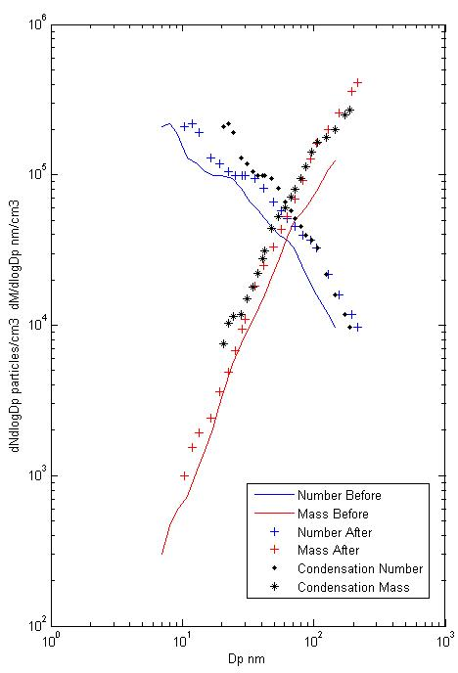
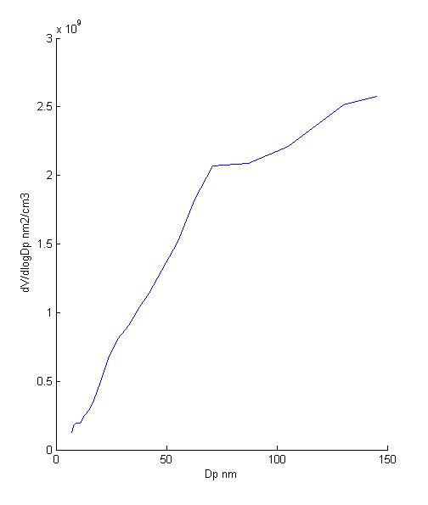
Further Study: Comparison to Condensation
SIO 217 D
Calculate the condensation scenario based on simplified assumptions:
-Same amount of mass transported to the aerosols;
-The amount of mass transferred is proportional to surface area;
2

